Slide 1
Welcome to my presentation
Sales Report-December, 2024
Analysis of Sales, Balance Sheet, and Profitability
Presented by:
Shamima Akter Meem
Batch No: 68
SL No.-10

Slide 2
Objectives of the Sales Report
Evaluate total sales, income, and expenses.
Identify top-performing products.
Analyze trends using graphs and charts.
Assist in decision-making for future sales strategies.

Slide 3
Sales Data Analysis
Sales calculated using SUM, Multiplication, and Subtraction functions.
Graphs created to visualize trends and product performance.
Major sales trends observed throughout the month.

Slide 4
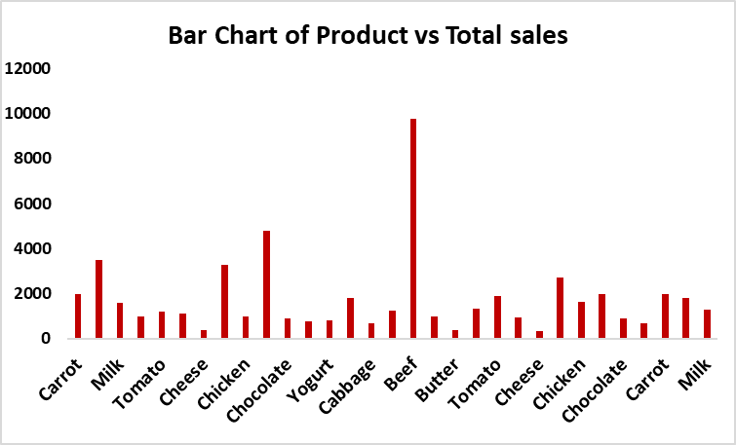
Product-wise Sales Analysis

Slide 5
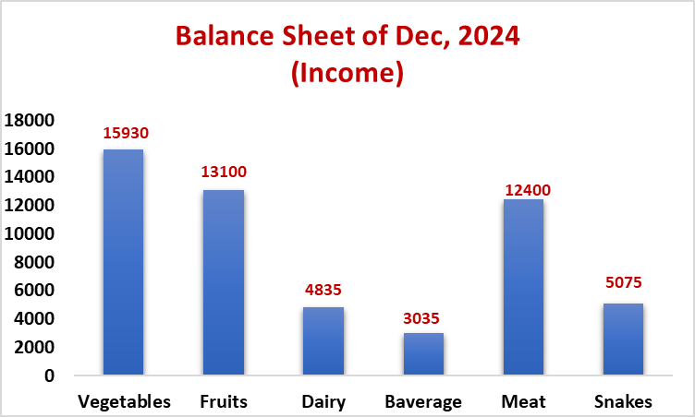
Income Breakdown (Balance Sheet)

Slide 6
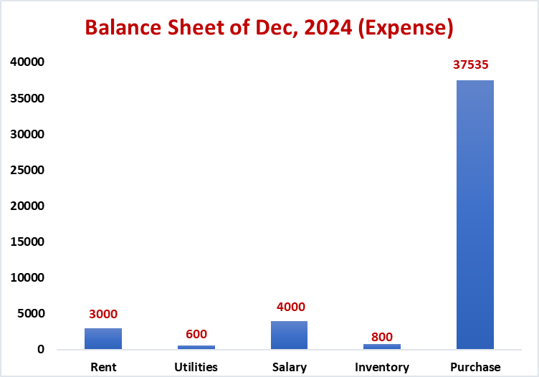
Expense Breakdown for December, 2024

Slide 7
Key Findings & Insights
High demand for vegetables, fruits, and meat.
Seasonal trends affecting sales.
Need for better marketing in low-performing categories.
Opportunities for cost optimization and increased revenue.

Slide 8
Recommendations & Conclusion
Focus on high-performing products for inventory management.
Improve marketing strategies for low-selling categories.
Monitor seasonal trends to optimize sales.
Use data insights for better decision-making.

Slide 9
Thank You

